Slide 1
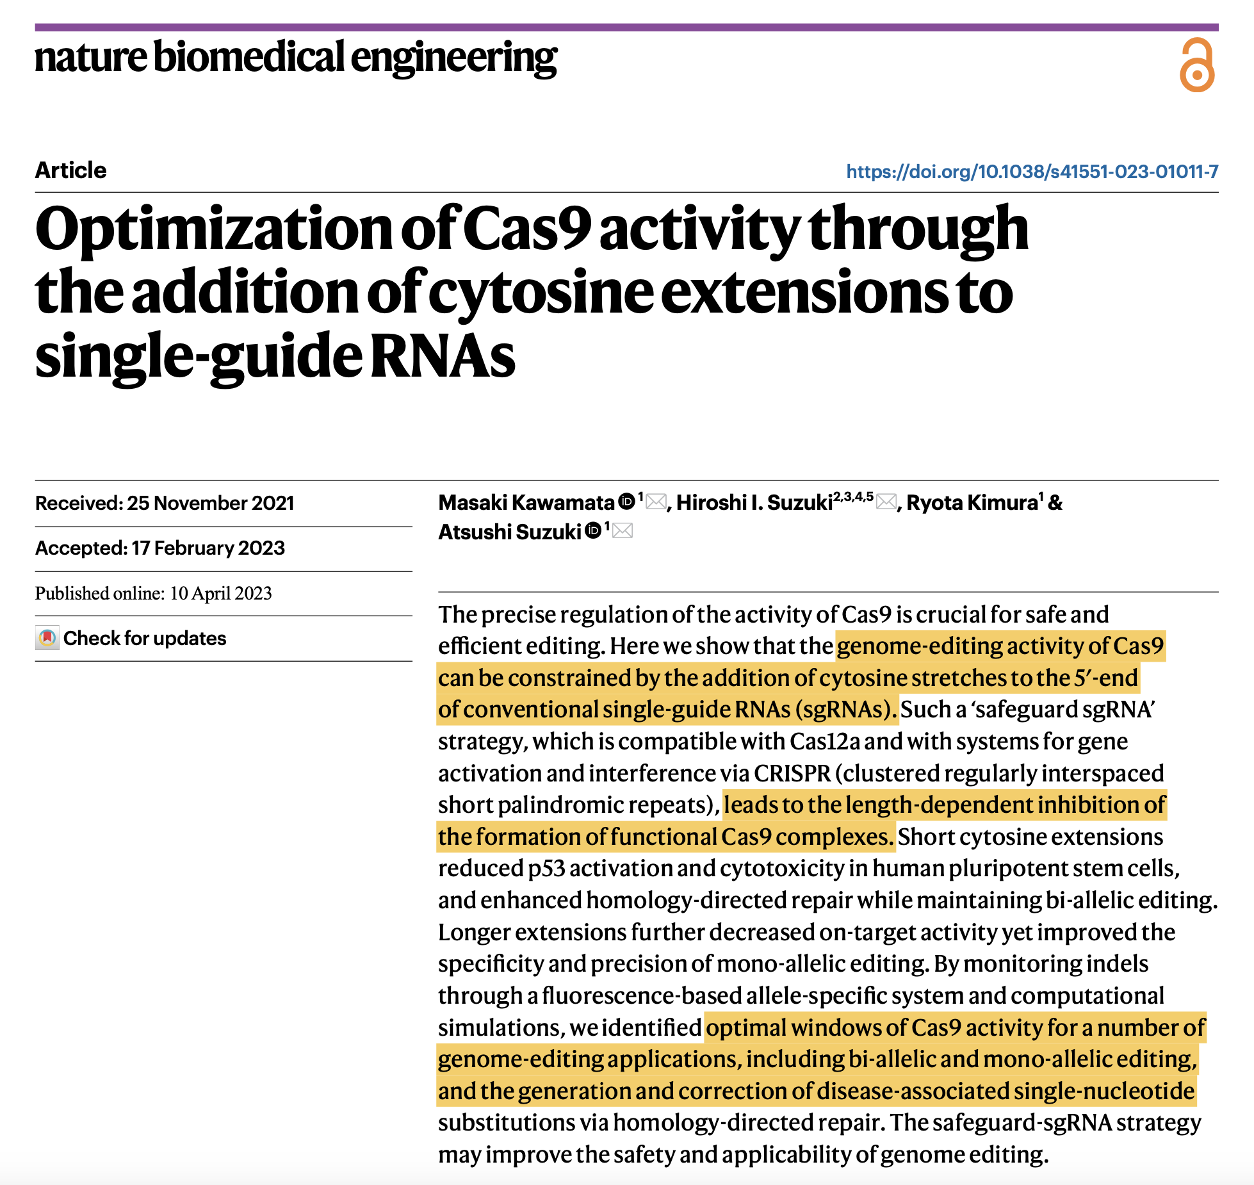

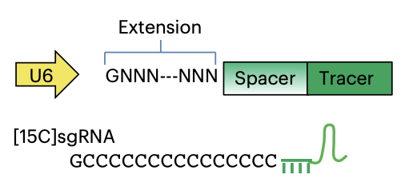
[C]sgRNA系统调控 CRISPR 活性

Slide 2
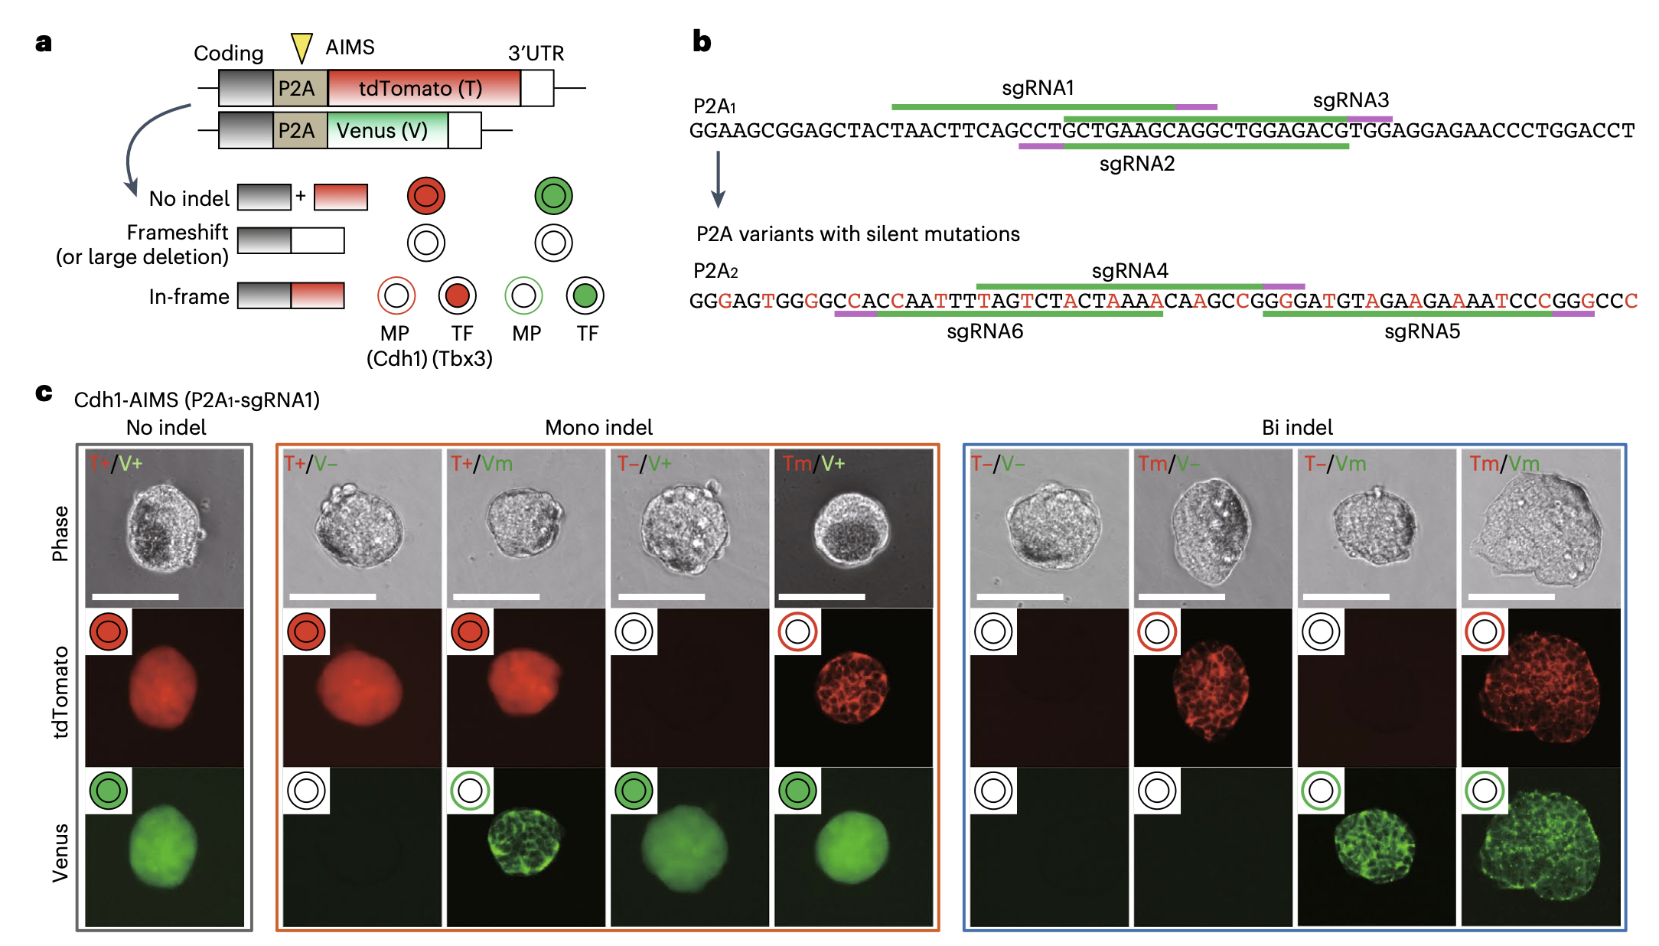
AISM: Allele-specific Indel Monitor System for the rapid and real-time quantitation of various editing patterns of a pair of alleles

Slide 3
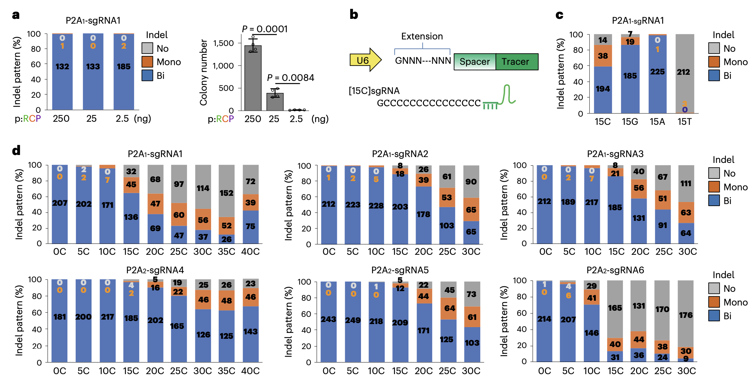
Fine-tuning of Cas9 activity with cytosine extension on sgRNAs

Slide 4
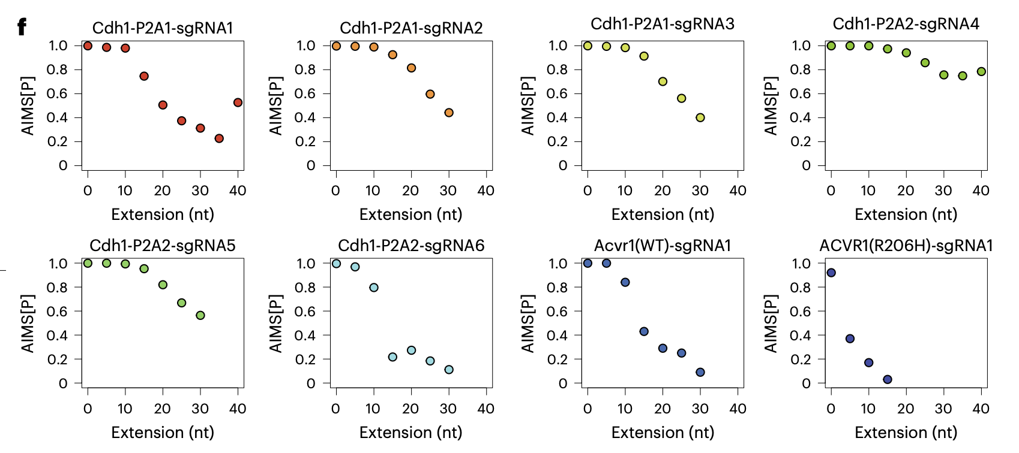
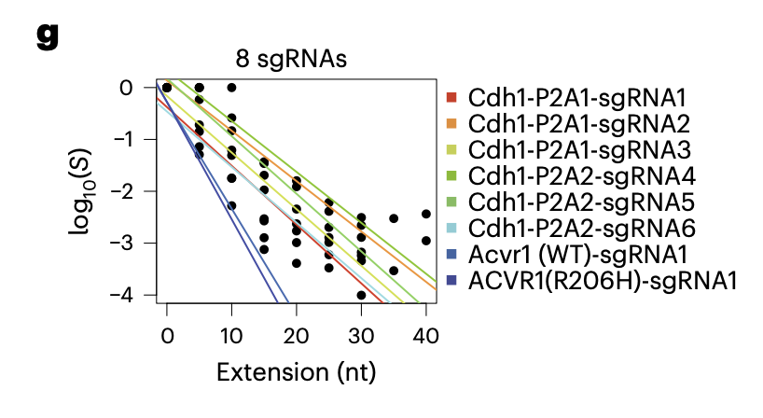
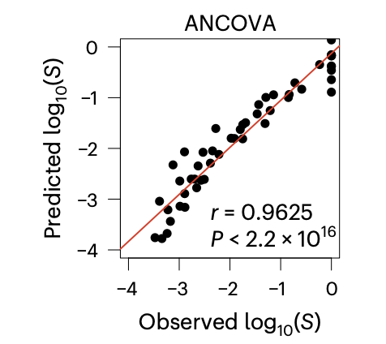
[C]sgRNA system work in a length-dependent manner, irrespective of the sgRNA sequence

Slide 5
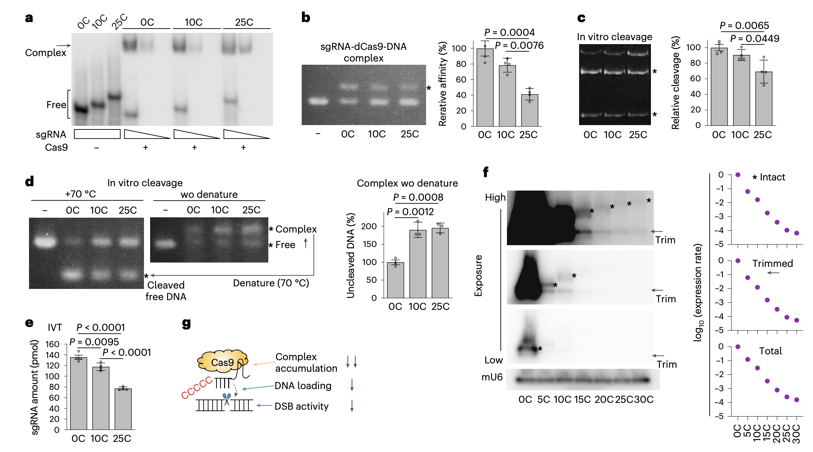
Mechanisms of Cas9 activity reduction via [C]sgRNAs system

Slide 6
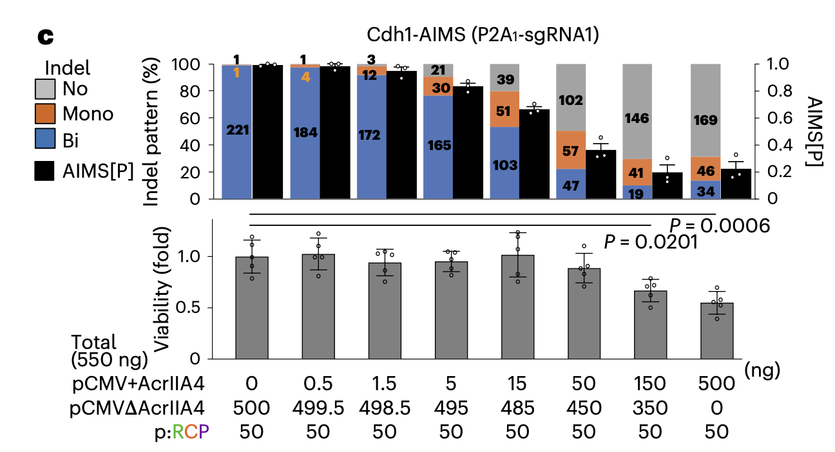
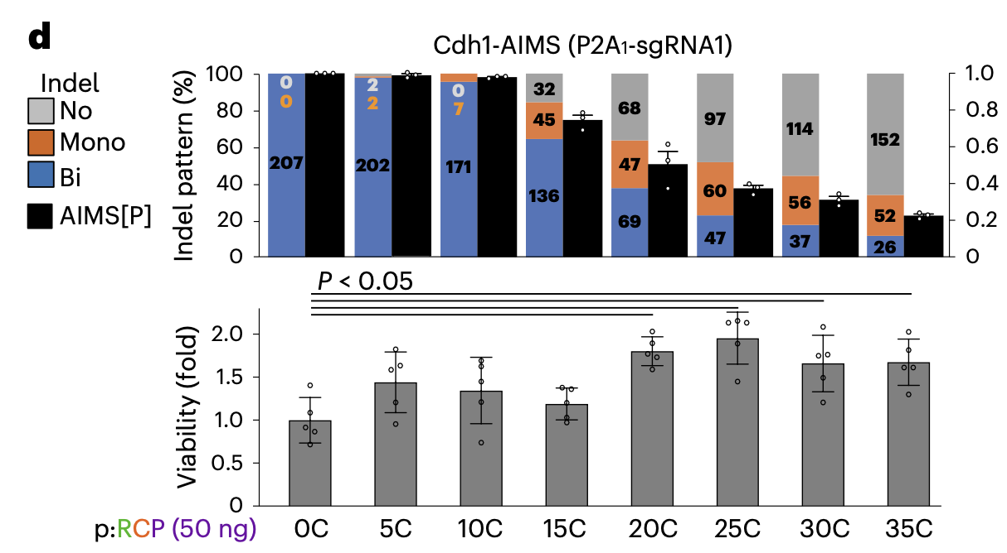
Comparisons between [C]sgRNA system and Cas9 inhibition using anti-CRISPR protein AcrIIA4
Cas9 inhibition through AcrIIA4
Cas9 inhibition through C-extension

Slide 7
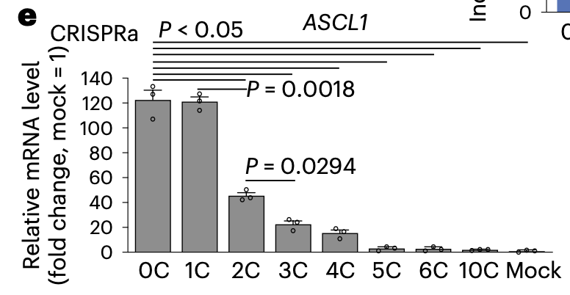
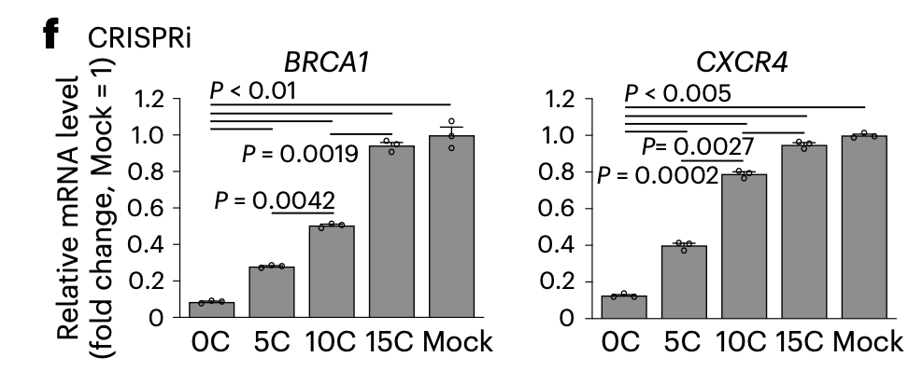
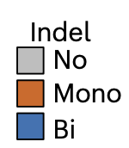
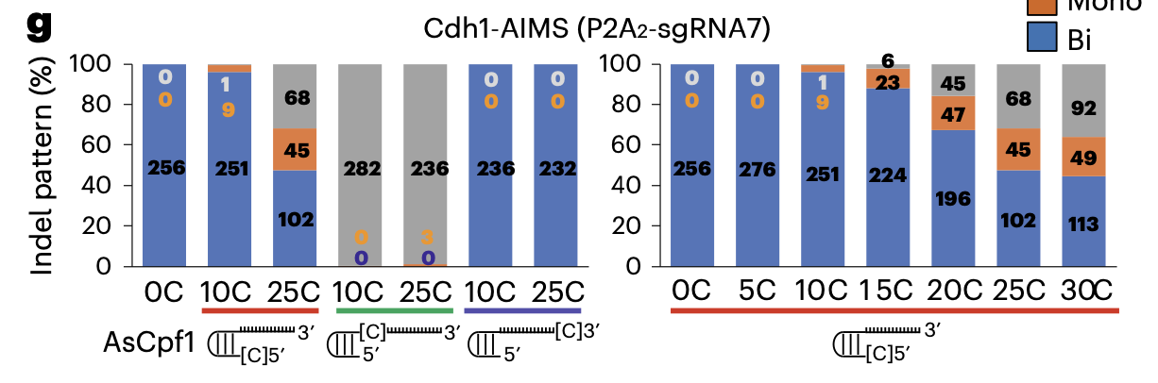
[C]sgRNA system is applicable to different CRISPR-based applications

Slide 8
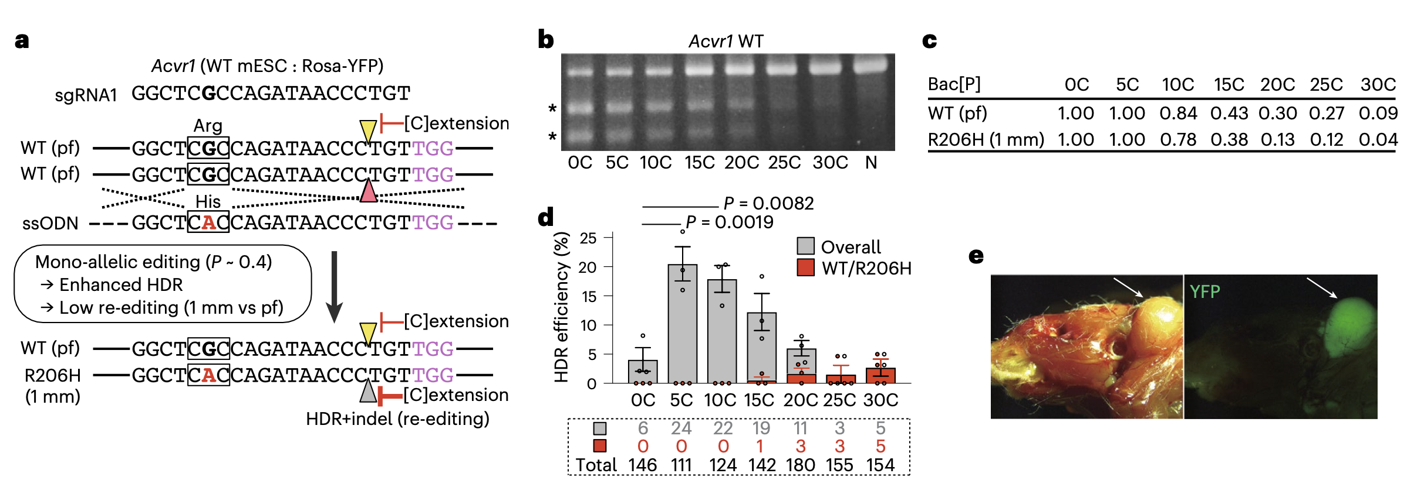
Generation of a heterozygous single-nucleotide polymorphism (SNP) disease model through optimized mono-allelic editing
All clones for [25C] and [30C]sgRNAs exhibited the correct WT/R206H genotype, whereas [0C]–[10C]sgRNAs did not induce precise editing

Slide 9
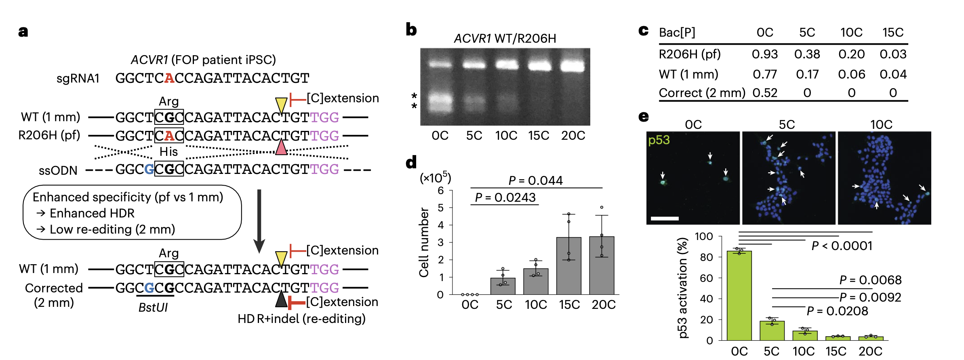
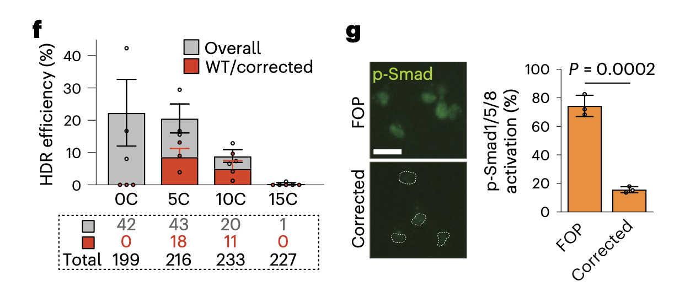
p53-activation-free systematic precise gene correction in human iPSCs

